Slide 1


Engineers’ Platform
Heba Mansour (RIM-140930)

Slide 2

Agenda
Problem statement
Project Idea Brief
Key features
Interfaces screenshots
Architecture and tools used
Summary and future works

Slide 3
Problem statement
Many skilled engineers struggle to promote their work or connect with investors.
Investors often lack a specialized, engineering‑focused hub to find qualified talent.
Existing platforms (e.g., GitHub, Behance) do not address these specific engineering‑investor matchmaking needs.

Slide 4
Project Idea Brief
Engineers’ Platform bridges technical expertise and real‑world opportunities through a cohesive digital ecosystem. Engineers can showcase their projects, manage their portfolios, and receive direct collaboration invitations, while investors discover qualified talent, propose new ideas, and send partnership requests. Platform administrators ensure safe interactions and high‑quality content at all times.

Slide 5

Key features

Slide 6
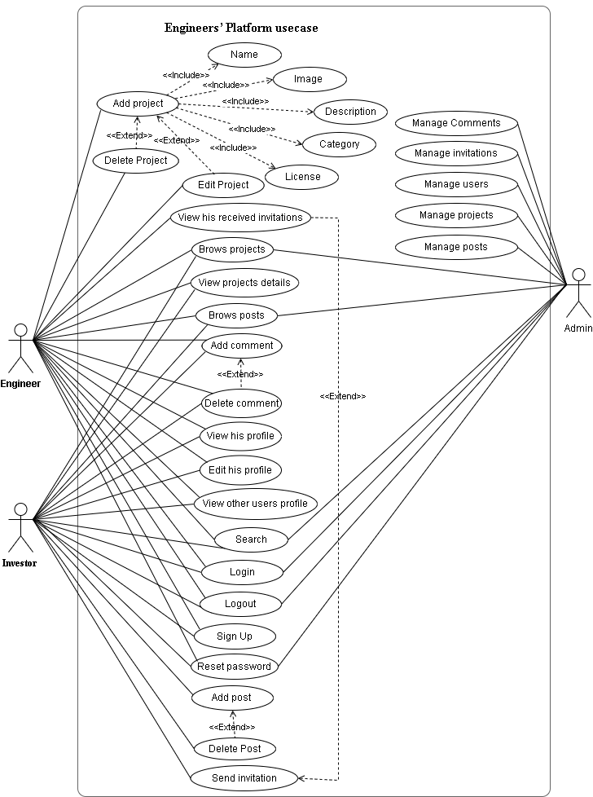
Use Case Diagram
6

Slide 7

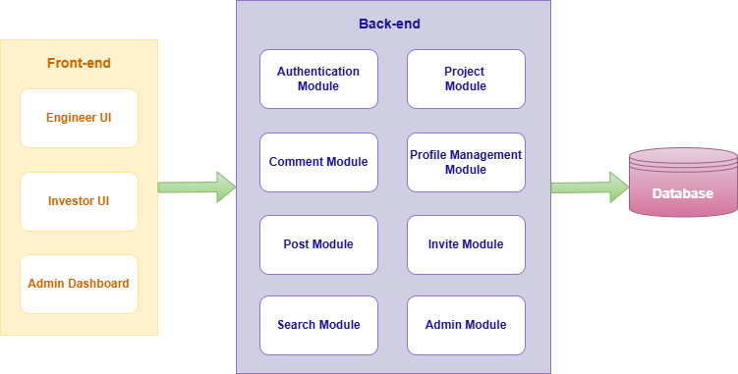
Bloc Diagram
7

Slide 8
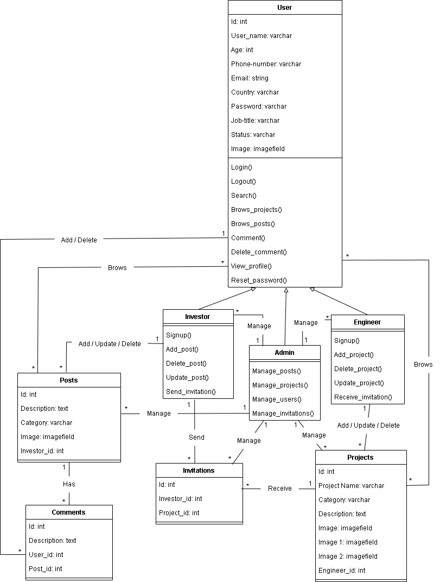
Class Diagram
8

Slide 9

My project interfaces Engineer interfaces

Slide 10
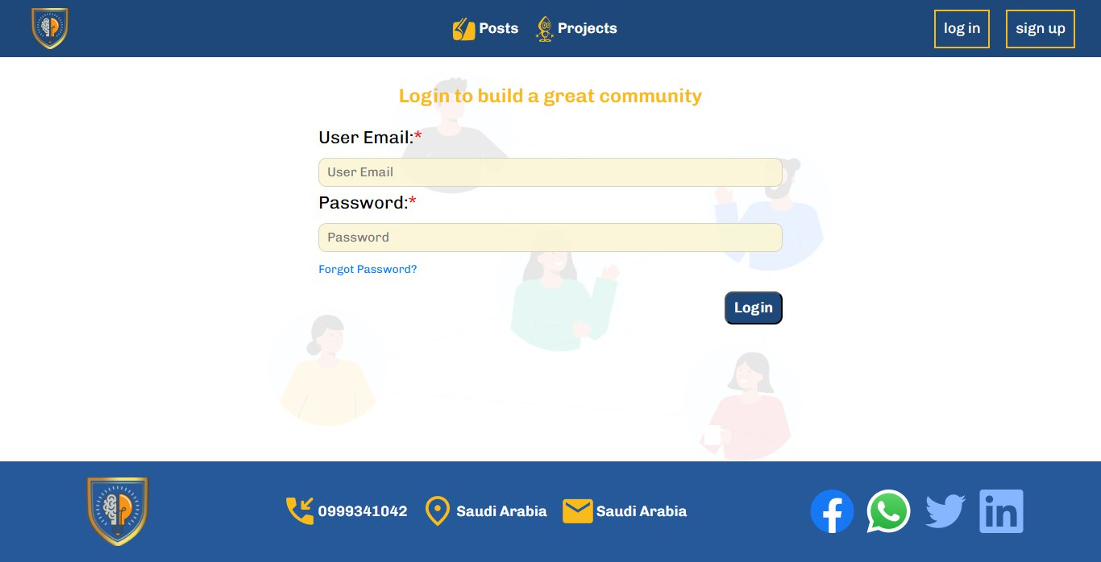
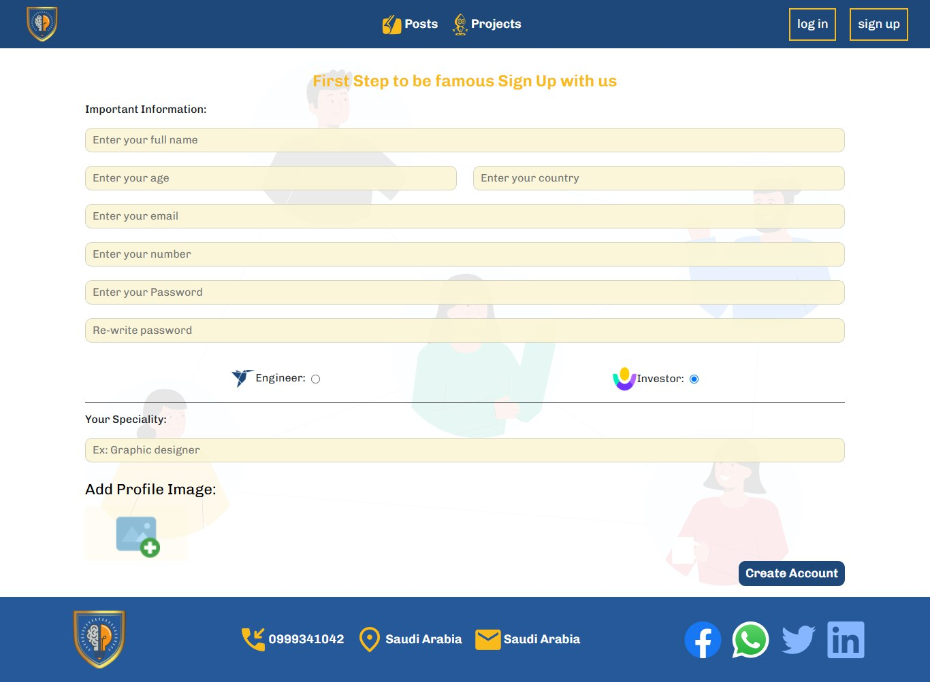
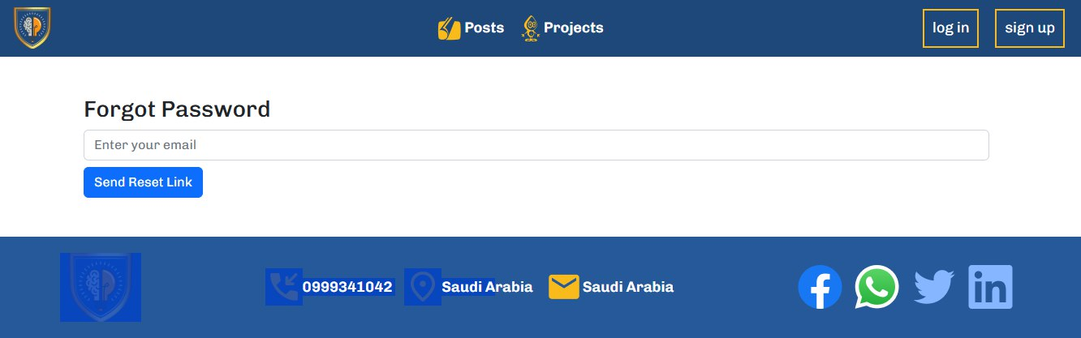
10
Signup interface
Login interface
Reset Password interface

Slide 11
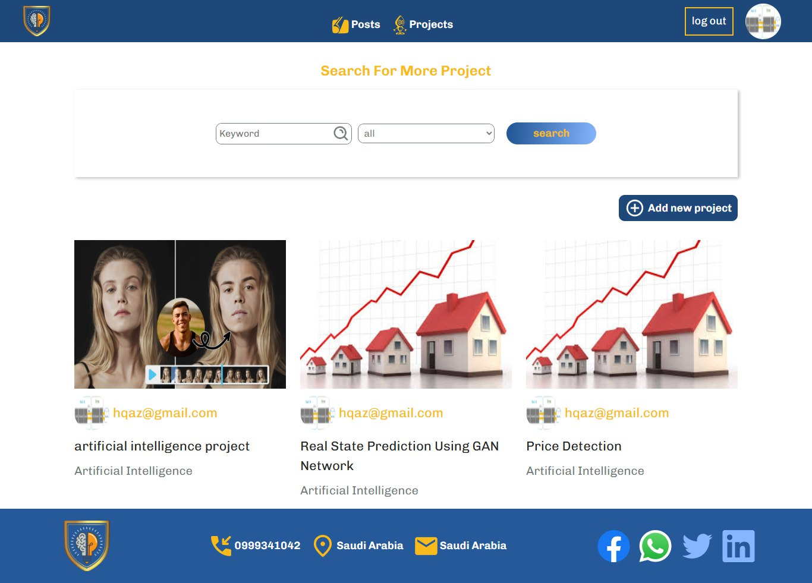
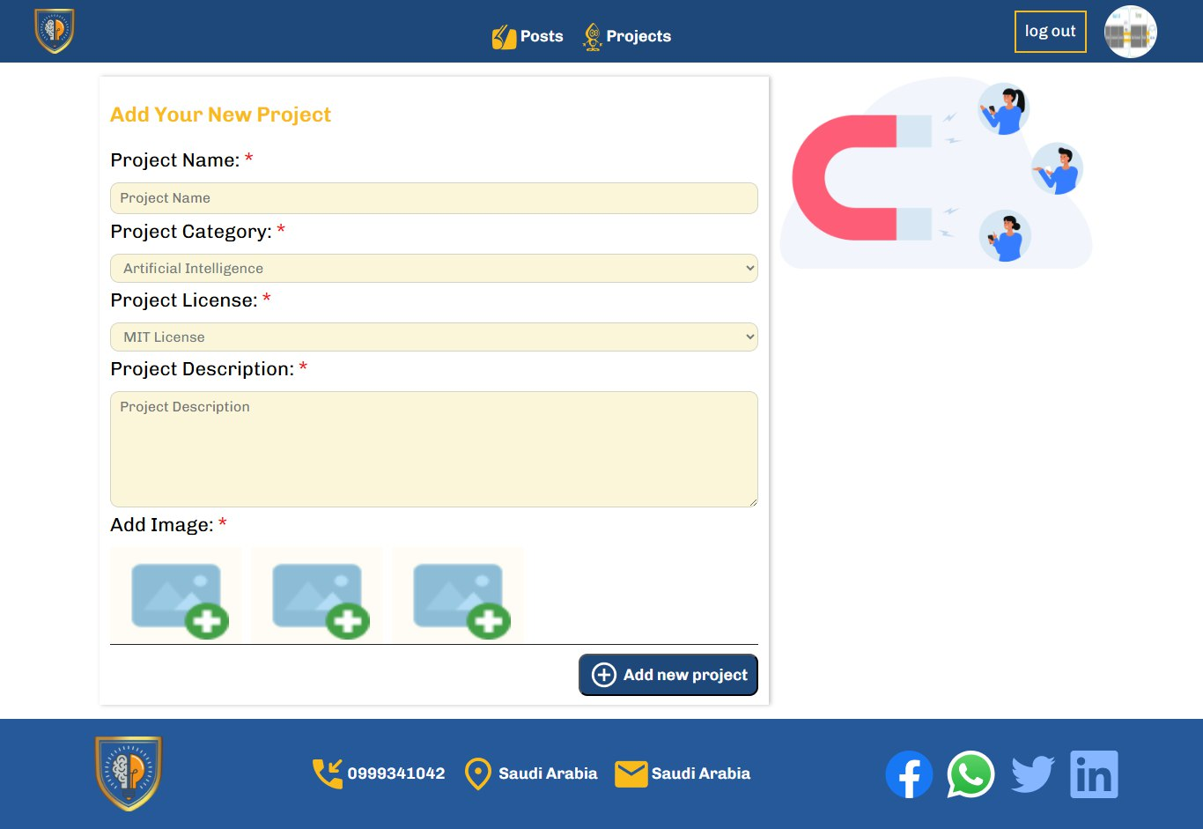
11
Add project interface
Search interface

Slide 12
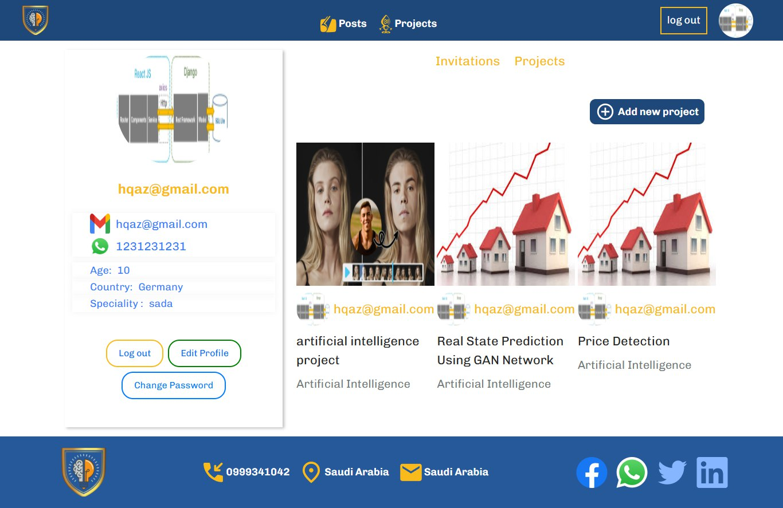
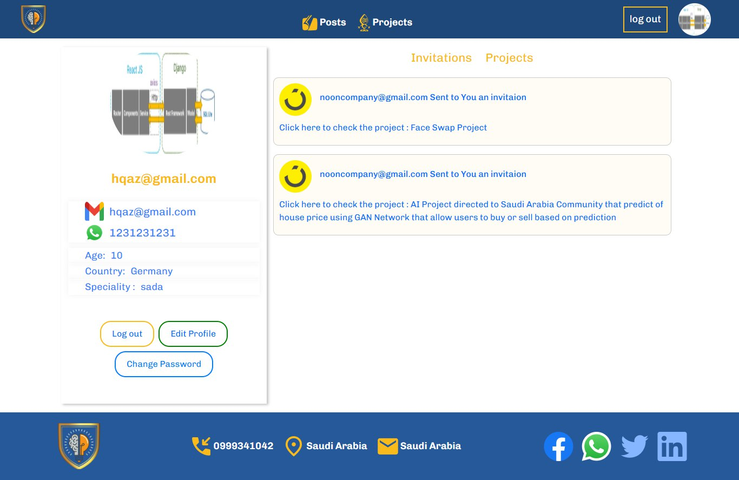
12
Received invitation interface
Engineer profile interface

Slide 13
My project interfaces Investor interfaces

Slide 14
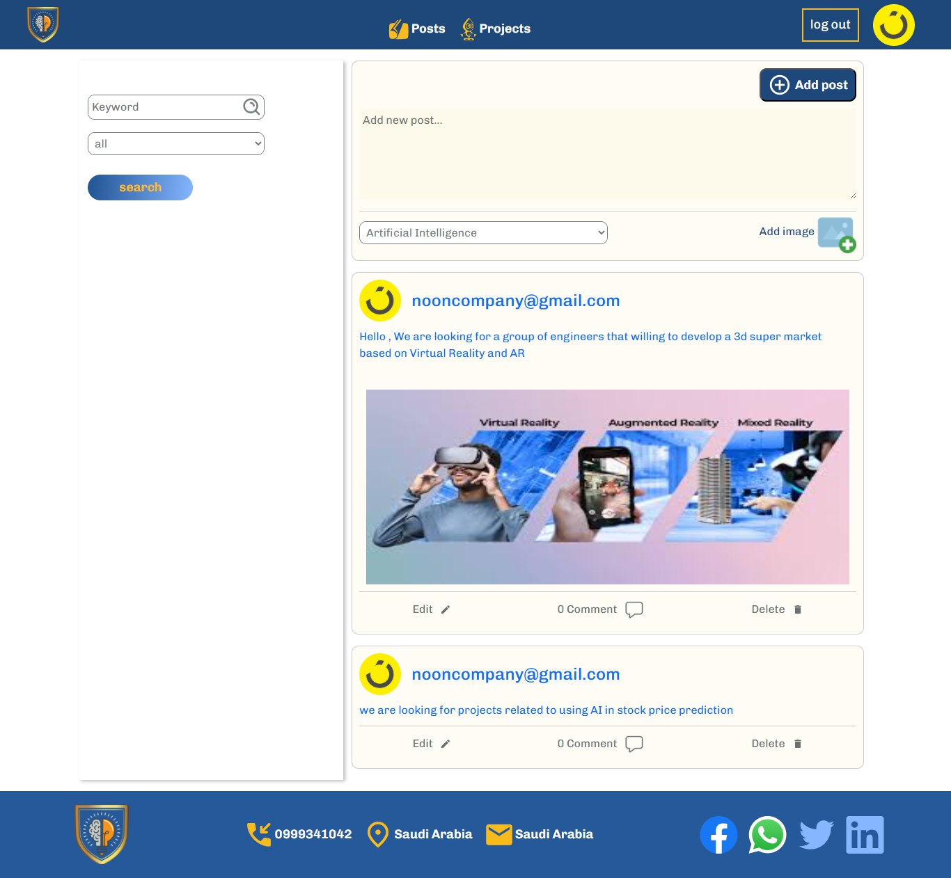
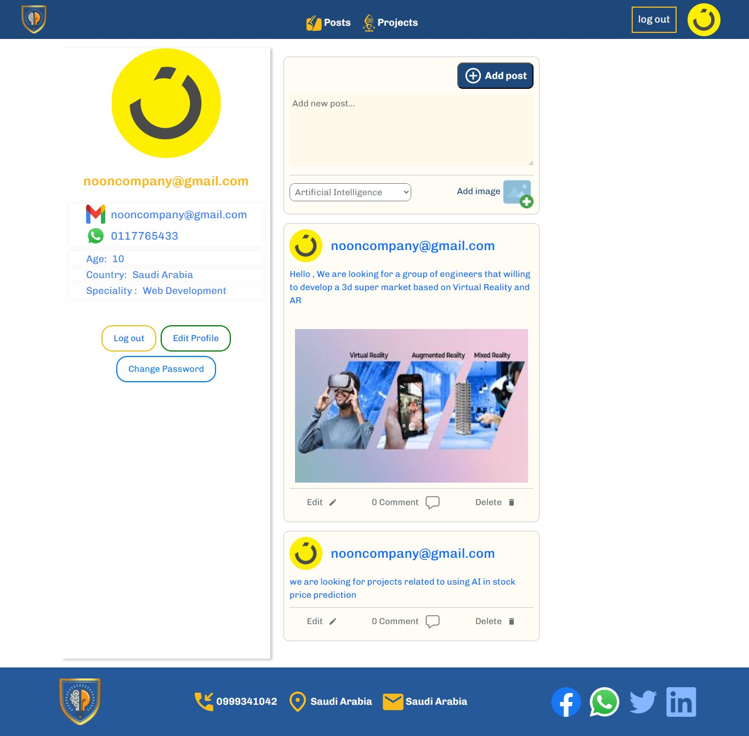
14
Investor profile interface
Posts interface

Slide 15
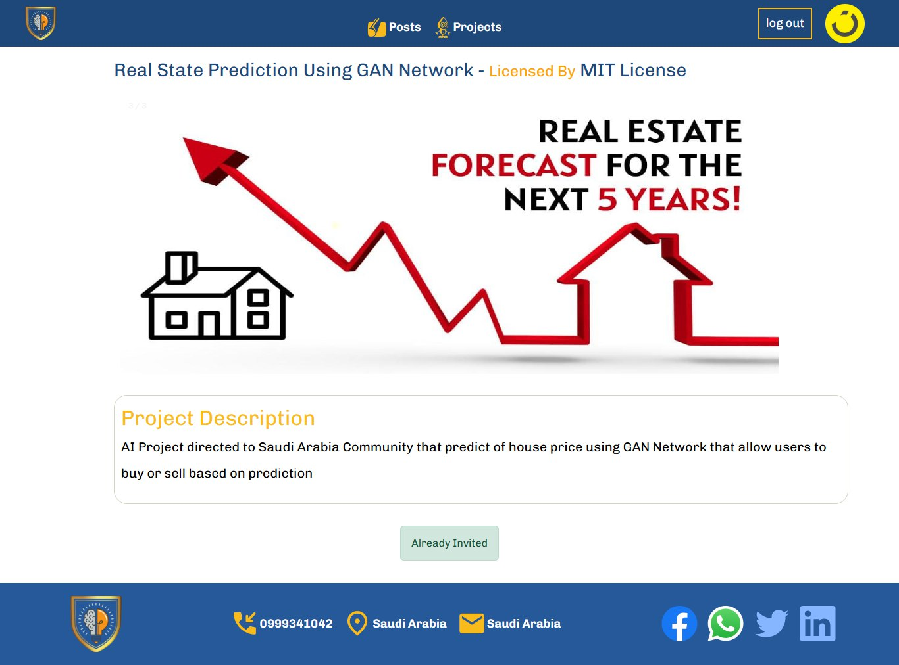
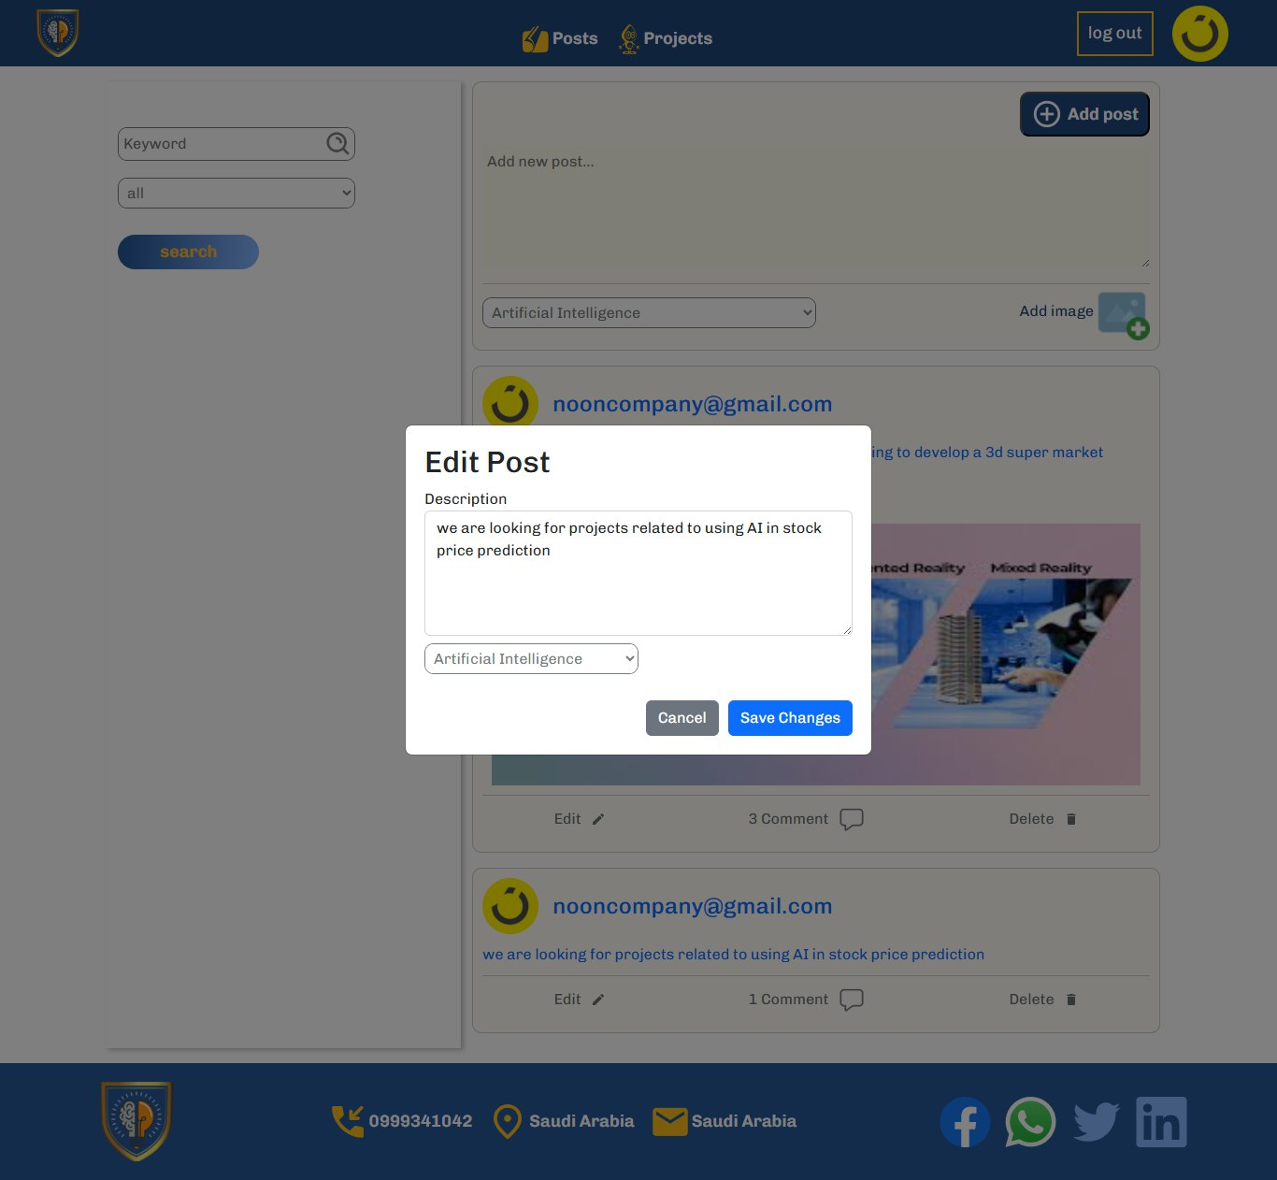
15
Edit post interface
Project details interface

Slide 16
My project interfaces Admin Dashboard

Slide 17
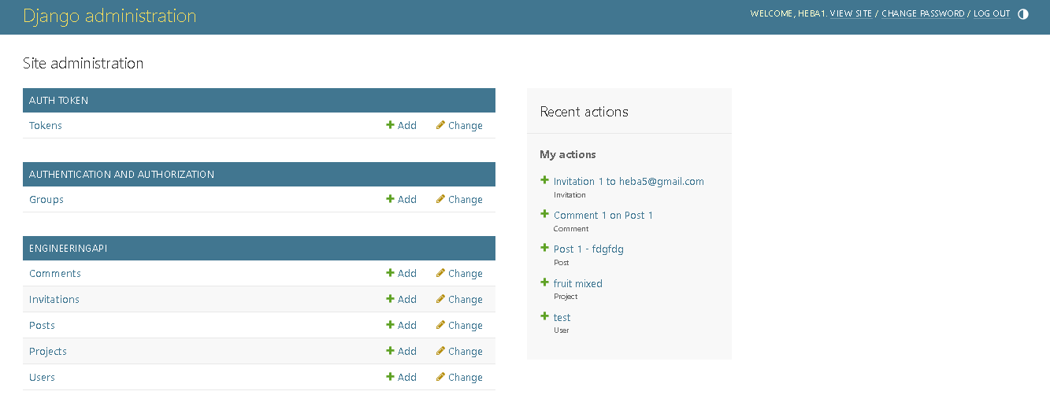
Admin dashboard

Slide 18
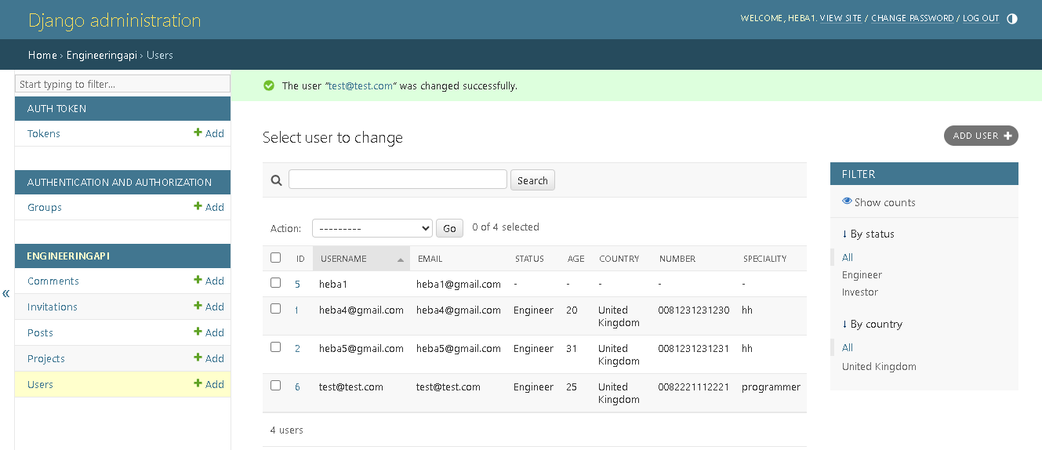
Manage users

Slide 19
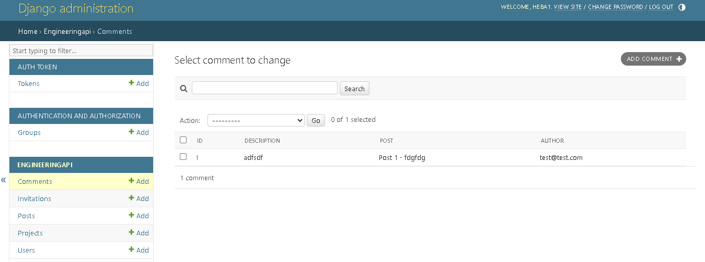
Manage comments

Slide 20
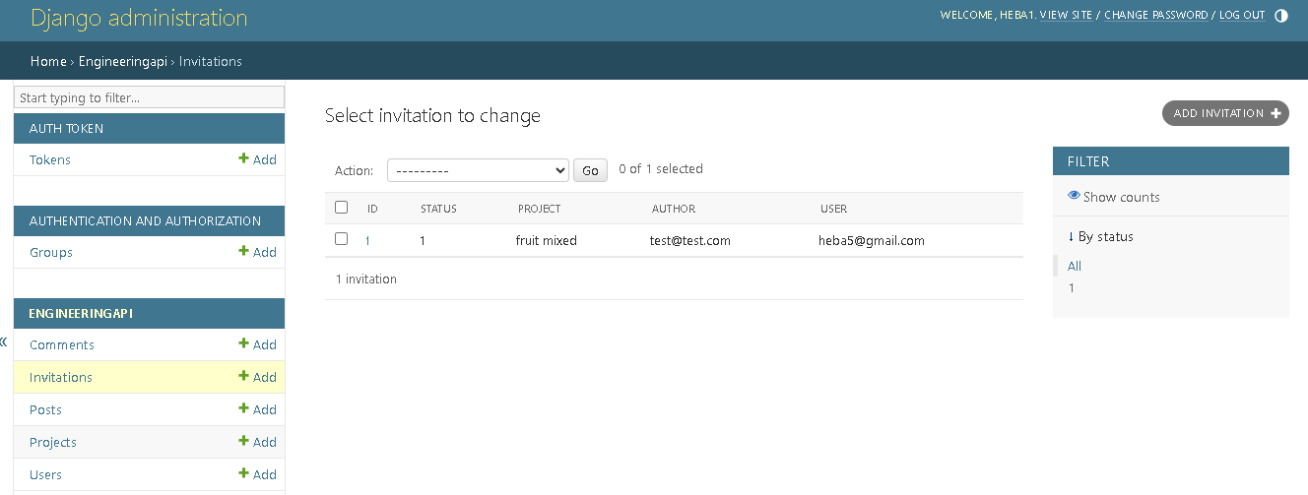
Manage invitation

Slide 21
Architecture and tools used

Slide 22

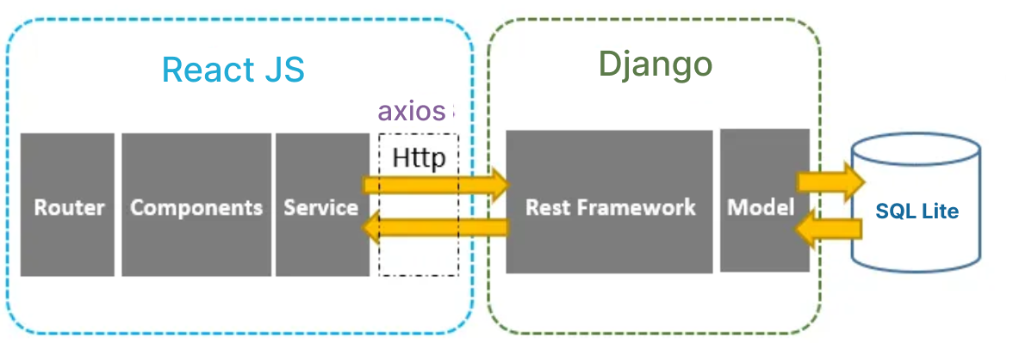
System architecture
22

Slide 23
Summary and reflections

Slide 24
Summary
Designing role-based permissions and custom DRF permissions.
Building modular APIs and secure authentication.
Integrating React frontend with Django backend seamlessly.

Slide 25
Future Work
Real-time messaging and notifications.
Rating/review system for projects.
Advanced AI-driven project recommendations.

Slide 26
Thank you

